Slide 1

Lecture 20 and 21
Fundamentals and Applications (CSO201A)
Dr. Srinivas Dharavath
Assistant Professor
Department of Chemistry
Indian Institute of Technology, Kanpur
Kanpur- 208016
E-mail: srinivasd@iitk.ac.in

Slide 2
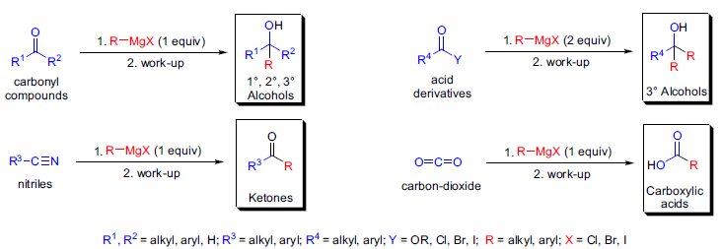


2. Cross-coupling types
A) Grignard Reaction
In 1900, V. Grignard reported that an alkyl halide (RX) reacts with magnesium metal (Mg) in diethyl ether to give a cloudy solution of an organomagnesium compound (RMgX), which upon reaction with aldehydes and ketones afforded secondary and tertiary alcohols, respectively.1 These organomagnesium compounds are called Grignard reagents, and their addition across carbon-heteroatom multiple bonds is referred to as the Grignard reaction. Soon after its discovery, the Grignard reaction became one of the most versatile C-C bond forming tools.

Slide 3
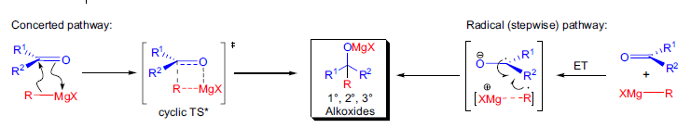
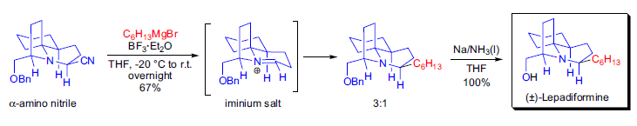

The mechanism of the formation of the Grignard reagent is most likely a single-electron-transfer (SET) process, and it takes place on the metal surface. The mechanism of the addition of Grignard reagents to carbonyl compounds is not fully understood, but it is thought to take place mainly via either a concerted process or a radical pathway (stepwise). It was found that substrates with low electron affinity react in a concerted fashion passing through a cyclic transition state. On the other hand, sterically demanding substrates and bulky Grignard reagents with weak CMg bonds tend to react through a radical pathway, which commences with an electron-transfer (ET) from RMgBr to the substrate.

Slide 4
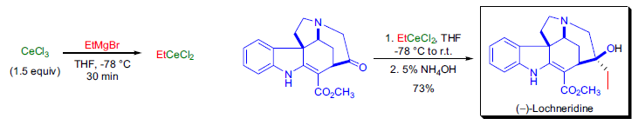
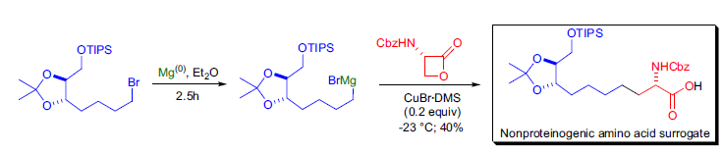

Slide 5
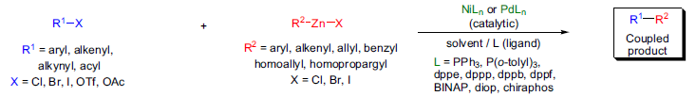

B) Negishi Coupling
The Pd- or Ni-catalyzed stereoselective cross-coupling of organozincs and aryl-, alkenyl-, or alkynyl halides is known as the Negishi cross-coupling. The general features of the reaction are: 1) both Ni- and Pdphosphine complexes work well as catalysts. However, the Pd-catalysts tend to give somewhat higher yields and better stereoselectivity, and their functional group tolerance is better; 2) the active catalysts are relatively unstable Ni(0)- and Pd(0)-complexes but these can be generated in situ from more stable Ni(II)- and Pd(II)-complexes with a reducing agent (e.g., 2 equivalents of DIBAL-H or n-BuLi); 3) in the absence of the transition metal catalyst, the organozinc reagents do not react with the alkenyl halides to any appreciable extent; 4) the most widely used ligand is PPh3, but other achiral and chiral phosphine ligands have been successfully used

Slide 6
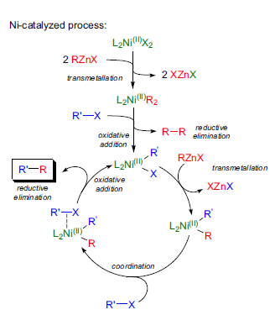
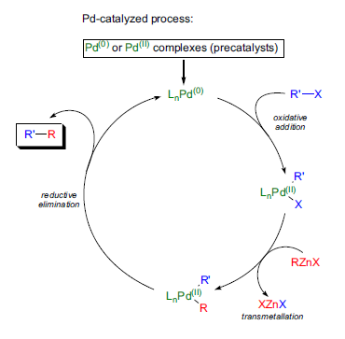


Slide 7
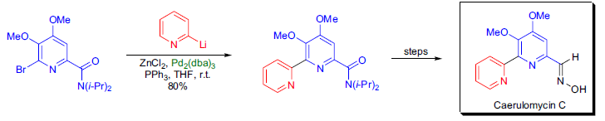
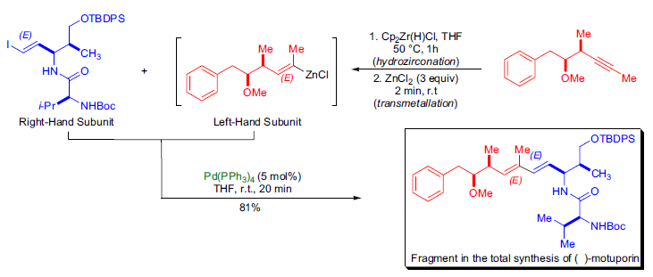


Slide 8
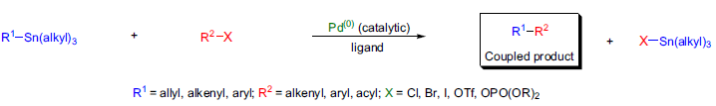

C) Stille Cross-Coupling
The Pd(0)-catalyzed coupling reaction between an organostannane and an organic electrophile to form a new C-C sigma bond is known as the Stille cross coupling. The precursor organotin compounds have many advantages because they: 1) tolerate a wide variety of functional groups; 2) are not sensitive to moisture or oxygen unlike other reactive organometallic compounds; and 3) are easily prepared, isolated, and stored.

Slide 9
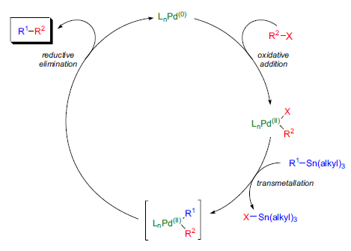

1979, although the detailed mechanism is still a matter of some debate. The catalytic cycle has three steps: 1) oxidative addition; 2) transmetallation; and 3) reductive elimination. The active catalyst is believed to be a 14-electron Pd(0)-complex which can be generated in situ. Palladium(0)-catalysts such as Pd(PPh3)4 and Pd(dba)2, with or without an added ligand, are often used. Alternatively, Pd(II)-complexes such as Pd(OAc)2, PdCl2(MeCN)2, (PdCl2(PPh3)2, BnPdCl(PPh3)2, etc. are also used as precursors for the catalytically active Pd(0) species, as these compounds are reduced by the organostannane or by an added phosphine ligand prior to the main catalytic process. The transmetallation step is the rate-determining step in the catalytic cycle. Different groups on the tin coupling partner transmetallate to the Pd(II) intermediate at different rates and the order of migration is: alkynyl > vinyl > aryl > allyl ~ benzyl »» alkyl. The very slow migration rate of the alkyl substituents allows the transfer of aryl or vinyl groups when mixed organostannanes containing three methyl or butyl groups are used.

Slide 10
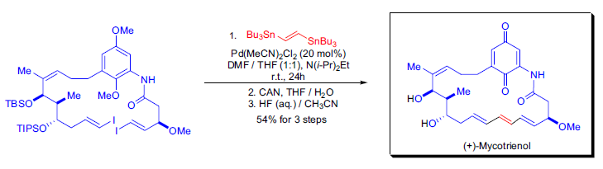
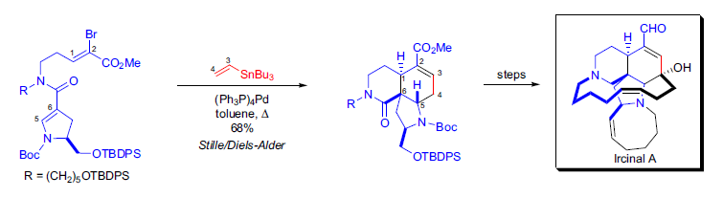


Slide 11
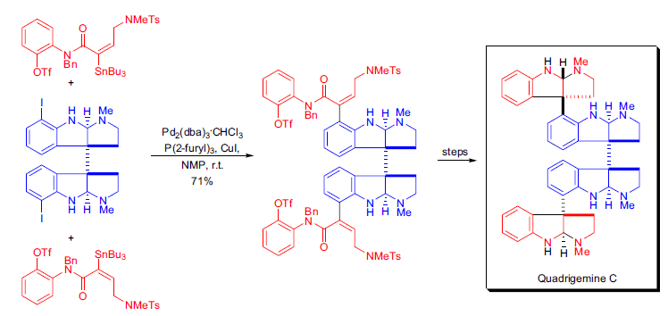


Slide 12
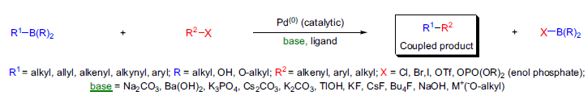

D) Suzuki Cross-Coupling
The palladium-catalyzed cross-coupling reaction between organoboron compounds and organic halides or triflates provides a powerful and general method for the formation of carbon-carbon bonds known as the Suzuki cross-coupling. There are several advantages to this method: 1) mild reaction conditions; 2) commercial availability of many boronic acids; 3) the inorganic by-products are easily removed from the reaction mixture, making the reaction suitable for industrial processes; 4) boronic acids are environmentally safer and much less toxic than organostannanes (see Stille coupling); 5) starting materials tolerate a wide variety of functional groups, and they are unaffected by water.

Slide 13
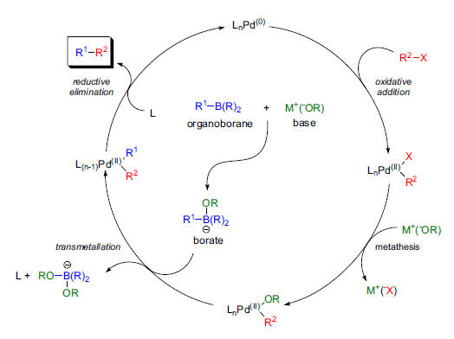

The mechanism of the Suzuki cross-coupling is analogous to the catalytic cycle for the other cross-coupling reactions and has four distinct steps: 1) oxidative addition of an organic halide to the Pd(0)-species to form Pd(II); 2) exchange of the anion attached to the palladium for the anion of the base (metathesis); 3) transmetallation between Pd(II) and the alkylborate complex; and 4) reductive elimination to form the C-C sigma bond and regeneration of Pd(0). Although organoboronic acids do not transmetallate to the Pd(II)-complexes, the corresponding ate-complexes readily undergo transmetallation. The quaternization of the boron atom with an anion increases the nucleophilicity of the alkyl group and it accelerates its transfer to the palladium in the transmetallation step. Very bulky and electron-rich ligands (e.g., P(t-Bu)3) increase the reactivity of otherwise unreactive aryl chlorides by accelerating the rate of the oxidative addition step.

Slide 14
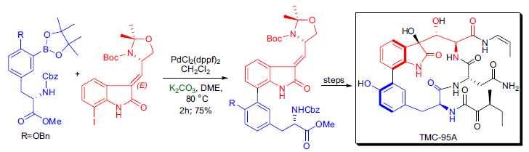
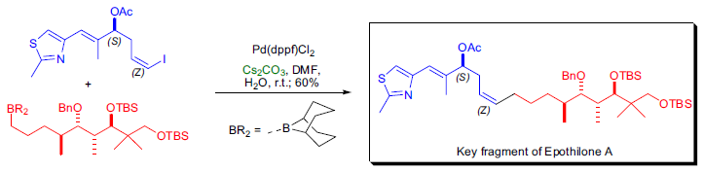


Slide 15
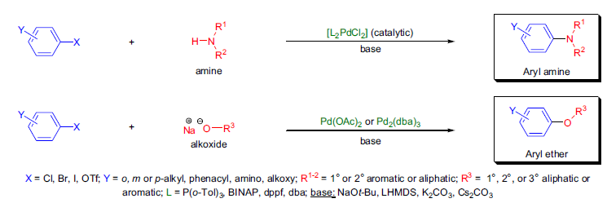

E) Buchwald-Hartwig Reaction
The direct Pd-catalyzed C-N and C-O bond formation between aryl halides or trifluoromethanesulfonates and amines (1° and 2° aliphatic or aromatic amines; imides, amides, sulfonamides, sulfoximines) or between aryl halides or triflates and alcohols (aliphatic alcohols and phenols) in the presence of a stoichiometric amount of base is known as the Buchwald-Hartwig cross-coupling.

Slide 16
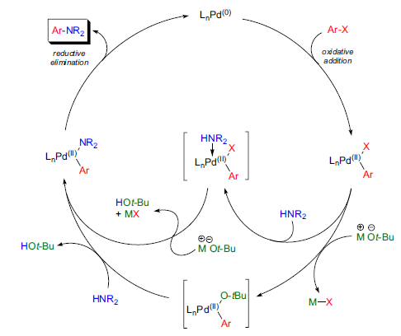

The first step in the catalytic cycle is the oxidative addition of Pd(0) to the aryl halide (or sulfonate). In the second step the Pd(II)-aryl amide can be formed either by direct displacement of the halide (or sulfonate) by the amide via a Pd(II)- alkoxide intermediate. Finally, reductive elimination results in the formation of the desired C-N bond and the Pd(0) catalyst is regenerated. Below is the catalytic cycle for the formation of an arylamine.

Slide 17
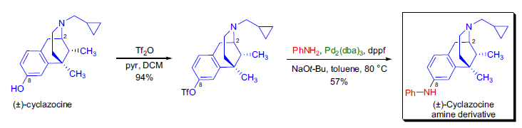
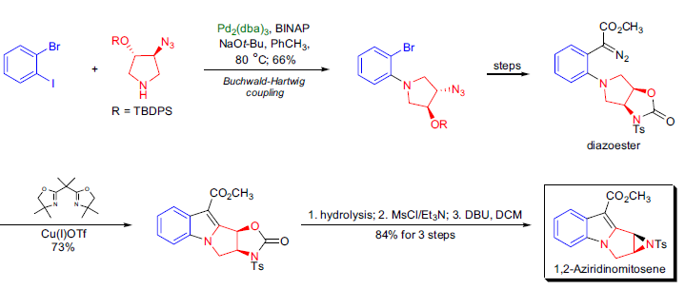


Slide 18
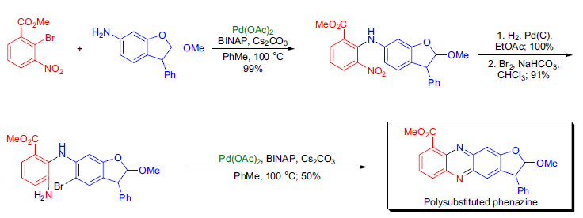


Slide 19
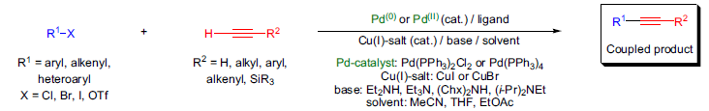

F) Sonogashira Coupling
The copper-palladium catalyzed coupling of terminal alkynes with aryl and vinyl halides to give enynes is known as the Sonogashira cross-coupling and can be considered as the catalytic version of the Castro-Stephens coupling. The general features of the reaction are: 1) the coupling can usually be conducted at or slightly above room temperature, and this is a major advantage over the forcing conditions required for the alternative Castro-Stephens coupling; 2) the handling of the shock-sensitive/explosive copper acetylides is avoided by the use of a catalytic amounts of copper(I) salt; 3) the copper(I) salt can be the commercially available CuI or CuBr and are usually applied in 0.5-5 mol% with respect to the halide or alkyne; 4) the best palladium catalysts are Pd(PPh3)2Cl2 or Pd(PPh3)4; 5) the solvents and the reagents do not need to be rigorously dried.

Slide 20
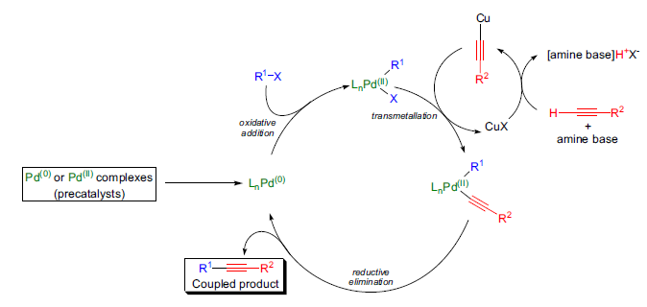
The mechanism of the Sonogashira cross-coupling follows the expected oxidative addition-reductive elimination pathway. However, the structure of the catalytically active species and the precise role of the CuI catalyst is unknown. The reaction commences with the generation of a coordinatively unsaturated Pd(0) species from a Pd(II) complex by reduction with the alkyne substrate or with an added phosphine ligand. The Pd(0) then undergoes oxidative addition with the aryl or vinyl halide followed by transmetallation by the copper(I)-acetylide. Reductive elimination affords the coupled product and the regeneration of the catalyst completes the catalytic cycle.

Slide 21
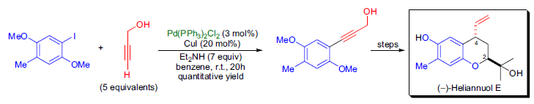
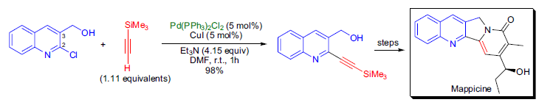


Slide 22
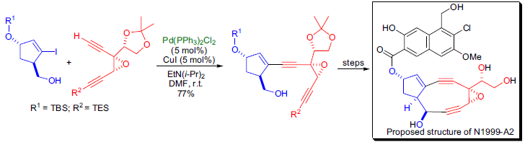
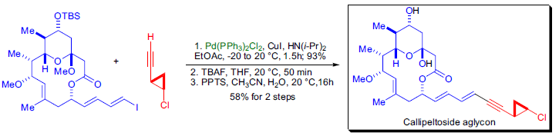


Slide 23
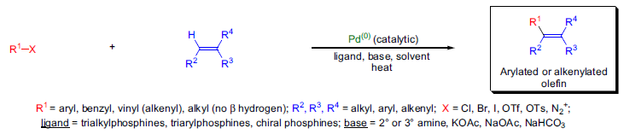

G) Heck Reaction
The palladium-catalyzed arylation or alkenylation of olefins is referred to as the Heck reaction. Since its discovery, the Heck reaction has become one of the most widely used catalytic carbon-carbon bond forming tools in organic synthesis. The general features of the reaction are: 1) it is best applied for the preparation of disubstituted olefins from monosubstituted ones; 2) the electronic nature of the substituents on the olefin only has limited influence on the outcome of the reaction; it can be either electron-donating or electron-withdrawing but usually the electron poor olefins give higher yields; 3) the reaction conditions tolerate a wide range of functional groups on the olefin component: esters, ethers, carboxylic acids, nitriles, phenols, dienes, etc., are all well-suited for the coupling, but allylic alcohols tend to rearrange; 4) the reaction rate is strongly influenced by the degree of substitution of the olefin and usually the more substituted olefin undergoes a slower Heck reaction.

Slide 24
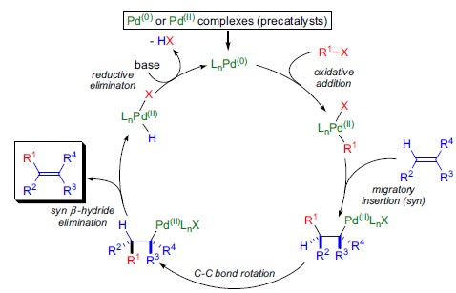

The scheme shows a simplified sequence of events beginning with the generation of the active Pd(0) catalyst. The rate-determining step is the oxidative addition of Pd(0) into the C-X bond. To account for various experimental observations, refined and more detailed catalytic cycles passing through anionic, cationic or neutral active species have been proposed

Slide 25
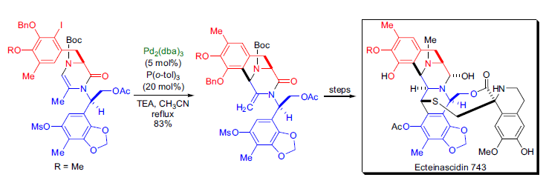
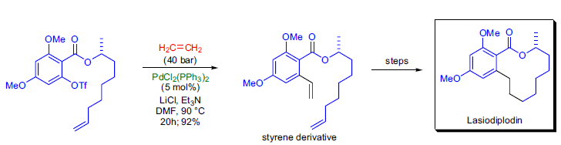


Slide 26
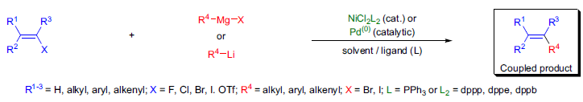

H) Kumada Coupling
During the 1970s a great deal of research effort was focused on the transition metal-catalyzed carbon-carbon bond forming reactions of unreactive alkenyl and aryl halides. In 1972, M. Kumada and R.J.P. Corriu independently discovered the stereoselective cross-coupling reaction between aryl- or alkenyl halides and Grignard reagents in the presence of a catalytic amount of a nickel-phosphine complex. In the following years, Kumada explored the scope and limitation of the reaction. Consequently, this transformation is now referred to as the Kumada cross-coupling. Nickel catalysis only worked for Grignard reagents and excluded the highly versatile organolithium reagents. Therefore, the use of alternative catalysts such as various palladium complexes was explored.19-24,26 The characteristic features of the Kumada cross-coupling are: 1) in the Ni-catalyzed process the catalytic activity depends largely on the nature of the phosphine ligand, and the following reactivity trend is observed: Ni(dppp)Cl2 > Ni(dppe)Cl2 > Ni(PR3)2Cl2 ~ Ni(dppb)Cl2; 2) even alkyl (sp3) Grignard reagents having β-hydrogens can selectively undergo crosscoupling reactions without any undesired β-hydride elimination; 3) with sec-alkyl Grignard reagents the alkyl group tends to isomerize to the corresponding primary alkyl group, and this isomerization is dependent on the basicity of the phosphine ligand and the nature of the aromatic halide

Slide 27
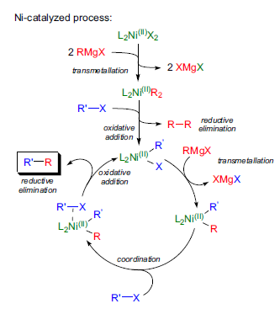
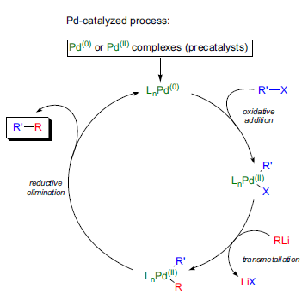


Slide 28
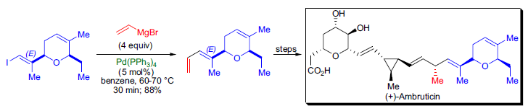
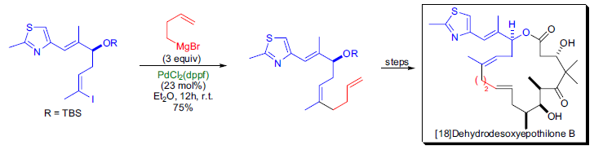


Slide 29
